Slide 1
Session 2
Classification of Food Security Risk Locations
Notes:
Before facilitating this session, confirm that each participant has a laptop and a copy of the Excel tool Classification of Food Security Risk Locations.
If possible, provide each participant with a blank map which outlines the geographical subdivisions of the region you are working in, or the regions that the participants will be working in. Sample blank maps are provided in the Session 2 folder.
This is a hands-on training session. As you explain how to use this tool, participants will simultaneously be entering mock data and using the tool.
Keep this slide on screen while people arrive and settle in for the session.

Slide 2
Today’s objectives:
Explain how the Risk Classification tool can be used to:
Identify geographic areas that could become food insecure during a pandemic
Classify these areas according to the risk of loss of food and livelihood security
Identify areas where you will need to collect more information
Prioritize regions in the municipality for preparedness and response activities
Notes:
Classifying food security risk locations will help your team understand why certain areas should be prioritized for preventative action and response efforts.
Another function of this tool is to provide a perspective on the types of preparedness and response activities that may reduce risk and lessen potential impacts on a specific area or population.

Slide 3
How can the Risk Classification tool help?
Gives estimates of areas within a region that are at high risk
Provides a measure of the relative risk in one area of a region in relation to another area in the same region
Cannot tell you exactly how many people will suffer from food insecurity
Notes:
Stress this point: All areas experience some level of risk.
The tool provides a measure of the relative risk in one area of a municipality in relation to another area in the same municipality. Risk level is classified into three categories: high, medium, and low. The ranking is based on the risk of loss of income and the ability to secure enough food to keep all members of a household healthy during a severe influenza pandemic.

Slide 4
How to use the Risk Classification tool
Before you use the tool you will need to enable Macros.
How you do this will depend on the version of Excel you are using
Office 1997-2003 a screen will pop up with instructions on how to enable Macros
Office 2007 – click this Options button on the upper left side of the screen
Notes:
Facilitator’s note: Have the group open the tool on their laptops and enable Macros.
Once Macros is enabled, have them click on the long green bar at the bottom of the page that says
“ Click here to skip this page and go directly to the tool” .
A questionnaire will open.

Slide 5
Information Entry Page
Notes:
Facilitator’s Note: Make sure that everyone in the group sees this image on their screen.
Have each participant type in the name of a targeted area.
The targeted area can be a district, a municipality, a village, or a dense urban zone. The size does not matter. However, to estimate relative risk, the chosen target areas should be similar subsets of a larger area.
For example, one participant may wish to examine the relative risk of communities located in one municipality; therefore each target area entered should be a village, a city, an urban zone, etc. One participant may choose to compare risk between target areas located in one department, province or state; therefore each target area entered should be a municipality, quarter, county, or similar country subdivision.

Slide 6
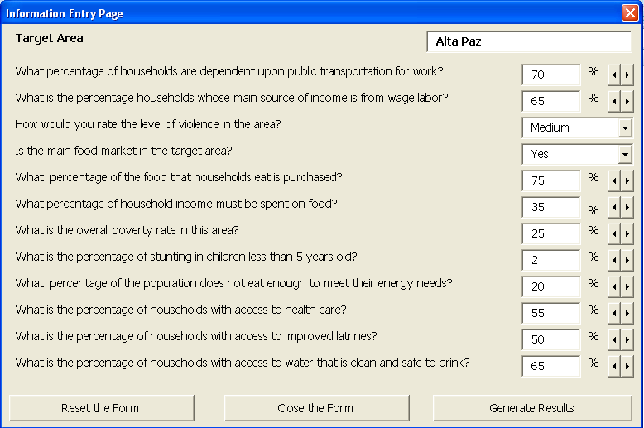
Information Entry Page
Enter information for each risk factor indicated in the questionnaire.
For today’s purpose, estimate the answers to the questions to the best of your ability
Notes:
A series of questions ask about various food and livelihood security risk factors indicators. The answers to these questions will help us to identify the target areas that could become food insecure as a result of a pandemic.
For training purposes, we will enter mock data. When you actually use the tool with your response team, you will gather information from existing data and expert knowledge. Existing data include food security and livelihood assessments, vulnerability assessments, government records, etc.
Ideally, the data you enter should be at the chosen target area level. If you can’t find some of the information at this level, the User’s Guide for this tool lists potential sources for accessing information, but most of the links provided are national level sources. Using data from these sources will work for an initial estimate, but it should be updated as soon as more accurate target level data is available.
Stress this point: If estimates are used in place of actual data, the results will help understand pandemic impact on food and livelihood security, however, these results should only be used for rough planning estimates until more accurate data are gathered within your municipality.
Facilitator’s Note: Once participants have entered all data, have them click the “Generate Results” button on the bottom right .

Slide 7
Risk Classification Page
Notes:
Facilitator’s Note: Make sure all participants see this page on their screen before continuing.
Here we see that the tool has summed up all the risk values from each of the questions on the information entry page. Based on the sum, the target area was assigned an overall level of risk, classified as low, medium, or high.
Click the mouse to show participants the sum ranges for classifying an area as LOW, MED, or HIGH.
Stress this point: Low risk is not the same as no risk. All areas will be at risk, but the classification system provides a way to compare the relative level of risk between areas.
The data you entered for each question on the information entry form was given a risk value of one to three, with three being the highest risk. For example, if you indicated that in the target area less than 15% of households use public transportation to get to work, a risk value of 1 was assigned to that question. If you indicated that more than 25% percent of households in the target area are reliant on public transportation to get to work, the risk value assigned is 3.
Facilitator’s Note: If participants want more information about how each risk value was calculated, have them refer to Handout 1 in the User’s Guide.

Slide 8
Add more target areas
Enter mock data for at least three more target areas.
Try to vary the mock data you enter so that you end up with a variety of risk classifications.
Remember to choose target areas that are similar subdivisions to your first entry.
Notes:
Facilitator’s Note: Have participants click the button at the top of the page that says “Add Another Target Area”
Give them 15-20 minutes to add mock data for at least 3 more target areas. The process will be identical to the data entry you just led them through.

Slide 9
Using the Risk Classifications to create a Risk Map
Notes:
Facilitator’s Note: If you have provided participants with blank maps of a region, they can now use their data to create a map similar to the sample on the screen by shading each target area based on its risk classification of low, medium, or high.
If you do not have maps, or do not want to take the time to do this exercise, simply explain the process and share the following information.
Making a Risk Map provides your team with a graphic representation of the risk at the targeted level which can help you decide where to prioritize preparedness and response efforts.

Slide 10
Prioritizing preparedness activities
Notes:
Facilitator’s Note: Have participants click on the button on the top right of whichever page they are on. Make sure that everyone in the group sees this image on their screen before continuing.
☞ Stress this point: Examining the level of risk assigned to each risk factor will help you to understand how each of the indicators (the questions from the information entry page) contributes to the overall risk of food and livelihood insecurity during a pandemic.
When a target area is assigned a risk value of three for a particular indicator, this suggests that this area is characterized by high risk for that indicator. If a target area is assigned a risk value of one, this suggests that this area is characterized by relatively low risk for that indicator.
The risk factor results help you to understand the main contributors to an area’s overall level of risk. The example on the screen shows us that this risk indicator for % of HH with access to clean, drinkable water is lower for the community of Santa Maria, than it is for the community of Santa Teresa.
This information helps you determine what types of preparedness and response activities might help lower the risk classification most quickly and what type of activities might not be appropriate for this area.
Looking at the sample Risk Factor page on the screen, we see that the target areas of both Santa Maria and Santa Teresa are classified as high risk (Level 3) for the following indicators: % of HHs needing public transportation to get to work, and % of HHs whose main source of income is wage labor. The community of Santa Teresa is additionally at high risk due to the % of the population that are food insecure (caloric deficit).
If the impact of the pandemic causes severe disruptions in transportation and economic systems, many people in these communities could experience a sharp decrease in their income, making it difficult for them to purchase food. Preparedness activities that provide information and/or resources about how to prepare for food shortages before the pandemic virus arrives, could help many in this population to protect their own food security during a pandemic.
Because people are already food insecure in the community of Santa Teresa, emergency food distribution will probably be a necessary response activity during a pandemic.

Slide 11
Thank You

